Slide 1
Syntax Analysis
Or
Parsing

Slide 2
Top Down Parsing
Find (build) a parse tree
Start building from the root and work down…
Equivalent as finding a left-most derivation
As we search for a derivation
  Must make choices:
    Which production rule to use
    Where to use it

Slide 3
Top-Down Parsing
Recursive-Descent Parsing
    Backtracking is needed (If a choice of a production rule does not work, we backtrack to try other alternatives)
    It is a general parsing technique, but not widely used
    Not efficient
Predictive Parsing
    no backtracking
    efficient
    needs a special form of grammars (LL(1) grammars)
    Non-Recursive (Table Driven) Predictive Parser is also known as LL(1) parser

Slide 4
Recursive-Descent Parsing
A recursive-descent parsing program consists of a set of procedures – one for each non-terminal
Execution begins with the procedure for the start symbol
Announces success if the procedure body scans the entire input

Slide 5
Recursive-Descent Parsing Algorithm
void A(){
for (j=1 to t){ /* t = number of A-productions */
Choose a A-production, A_{j}→X₁X₂…X_{k};
for (i=1 to k){
if (X_{i} is a non-terminal)
call procedure X_{i}();
else if (X_{i} equals the current input symbol a)
advance the input to the next symbol;
else backtrack in input and reset the pointer
}
}
}

Slide 6
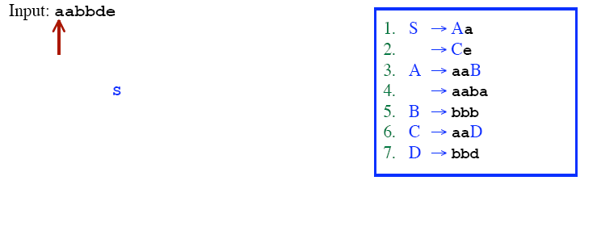
Recursive Descent Parsing (Backtracking)

Slide 7
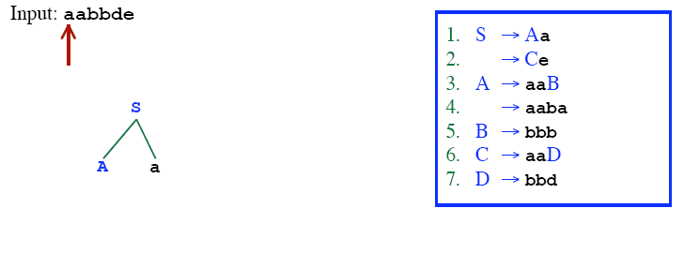
Recursive Descent Parsing (Backtracking)

Slide 8
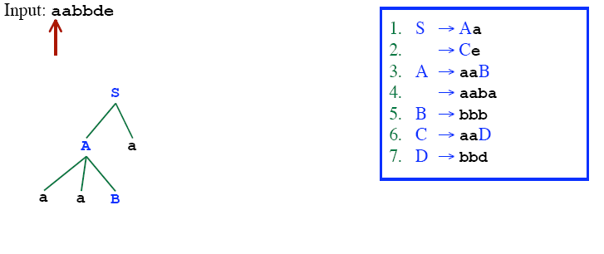
Recursive Descent Parsing (Backtracking)

Slide 9
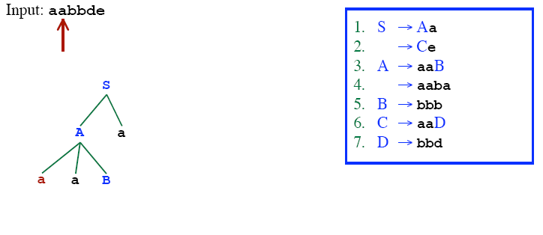
Recursive Descent Parsing (Backtracking)

Slide 10
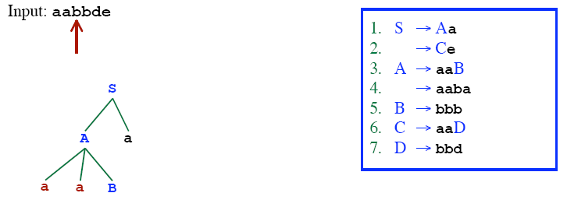
Recursive Descent Parsing (Backtracking)

Slide 11
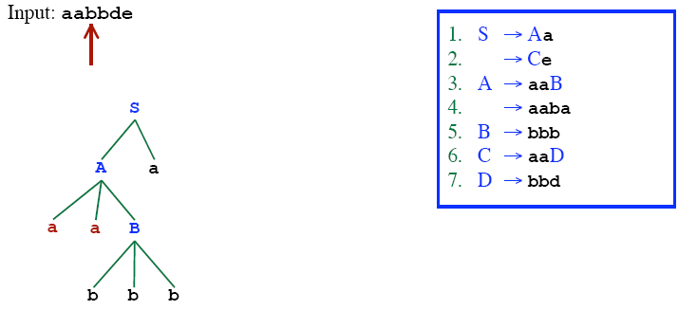
Recursive Descent Parsing (Backtracking)

Slide 12
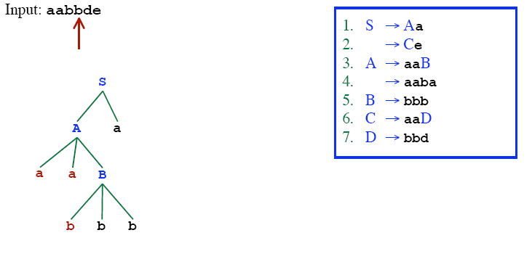
Recursive Descent Parsing (Backtracking)

Slide 13
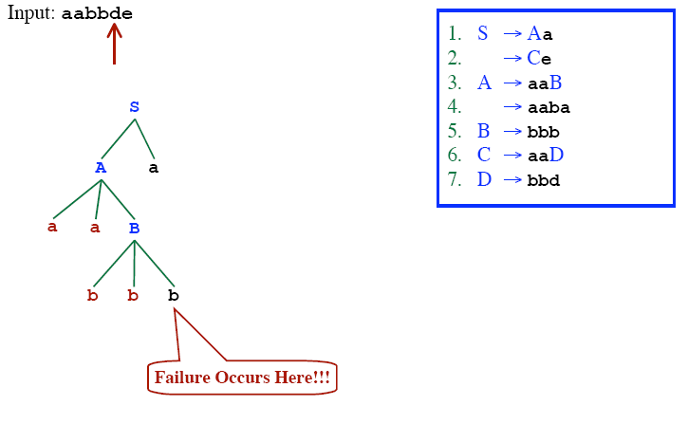
Recursive Descent Parsing (Backtracking)

Slide 14
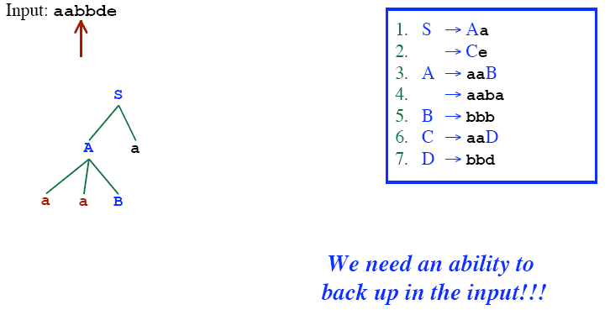
Recursive Descent Parsing (Backtracking)

Slide 15
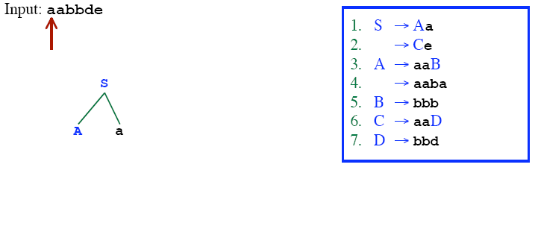
Recursive Descent Parsing (Backtracking)

Slide 16
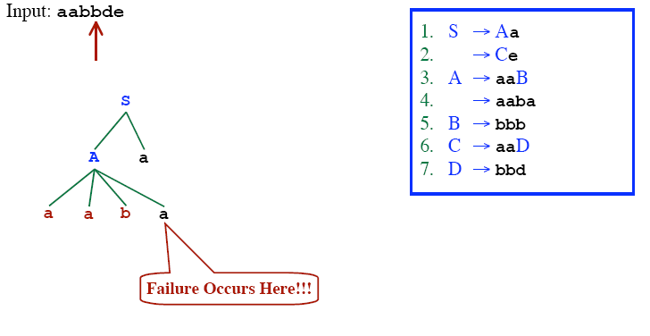
Recursive Descent Parsing (Backtracking)

Slide 17
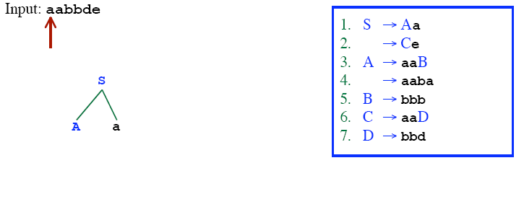
Recursive Descent Parsing (Backtracking)

Slide 18
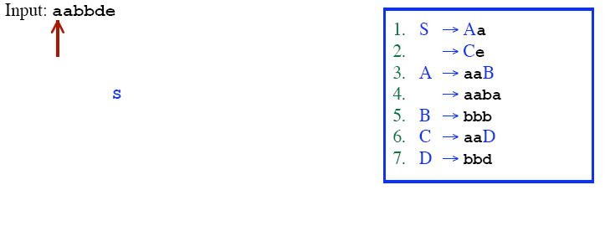
Recursive Descent Parsing (Backtracking)

Slide 19
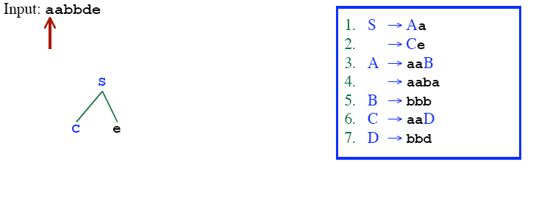
Recursive Descent Parsing (Backtracking)

Slide 20
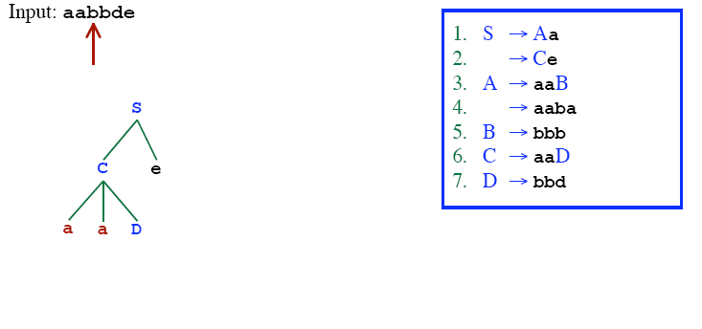
Recursive Descent Parsing (Backtracking)

Slide 21
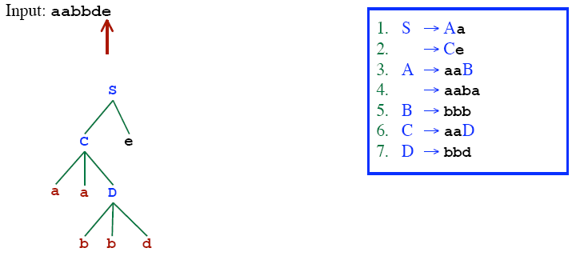
Recursive Descent Parsing (Backtracking)

Slide 22
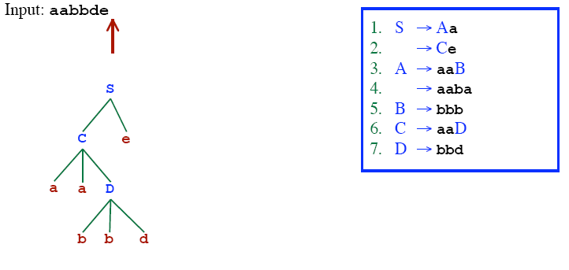
Recursive Descent Parsing (Backtracking)
Successfully parsed!!

Slide 23
Predictive Parser
When re-writing a non-terminal in a derivation step, a predictive parser can uniquely choose a production rule by looking at the current symbol in the input string
A → α₁ | ... | α_{n} input: ... a .......
current token

Slide 24
Predictive Parser (example)
stmt → if ...... |
while ...... |
begin ...... |
for .....
When we are trying to write the non-terminal stmt, if the current token is if we have to choose first production rule
When we are trying to expand the non-terminal stmt, we can uniquely choose the production rule by just looking the current token
We eliminate existing left recursion in the grammar, and left factor it
  But it may not be suitable for predictive parsing (not LL(1) grammar)

Slide 25
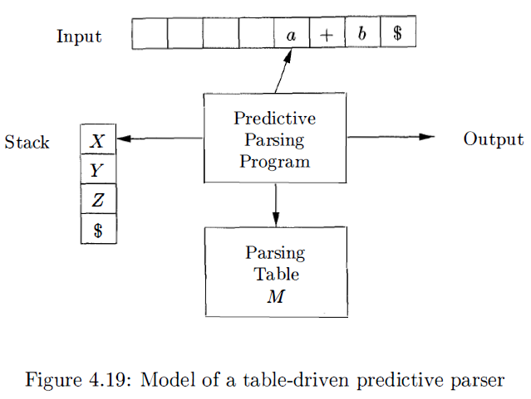
Predictive Parser

Slide 26
Predictive Parsing
Each non-terminal corresponds to a procedure.
Ex: A → aBb (This is only the production rule for A)
proc A {
- match the current token with a, and move to the next token;
- call ‘B’;
- match the current token with b, and move to the next token;
}

Slide 27
Recursive Predictive Parsing (cont.)
A → aBb | bAB
proc A {
case of the current token {
‘a’: - match the current token with a, and move to the next token;
- call ‘B’;
- match the current token with b, and move to the next token;
‘b’: - match the current token with b, and move to the next token;
- call ‘A’;
- call ‘B’;
}
}

Slide 28
Recursive Predictive Parsing (cont.)
When to apply ε-productions.
A → aA | bB | ε
If all other productions fail, we should apply an ε-production. For example, if the current token is not a or b, we may apply the ε-production
Most correct choice: We should apply an ε-production for a non-terminal A when the current token is in the follow set of A (which terminals can follow A in the sentential forms)

Slide 29
Predictive Parsing
LL(1) Grammars
  Can do predictive parsing
  Looking at the next 1 input symbol
    First L : Left to Right Scanning
    Second L: Leftmost derivation
    1 : one input symbol look-ahead for predictive decision
LL(k) Grammars
  Can do predictive parsing
  Looking at only the next k input symbols

Slide 30
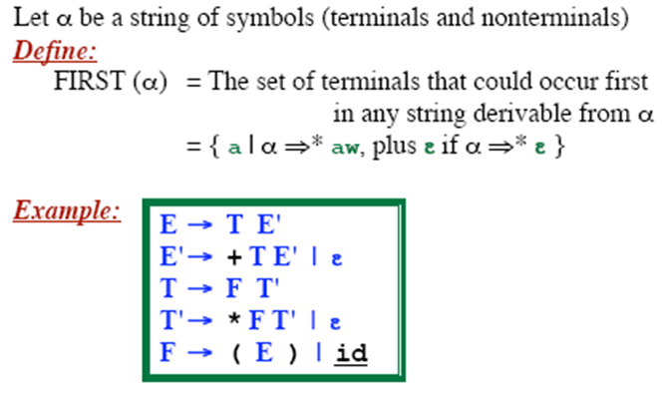
First Function
FIRST (E) =
FIRST (E’) =
FIRST (T) =
FIRST (T’) =
FIRST (F) =

Slide 31
First function Computation
1. If X is terminal, FIRST(X) = {X}
2. If X → ε is a production,
or X → y₁y_{2…}y_{k}, where each of first(y₁), first(y₂),…,first(y_{k}) contains ε,
then add ε to FIRST(X)
3. If X → aα, a is terminal and α is set of terminal/ nonterminal: FIRST(X) = {a}
4. If X → Bα(provided B≠ ε): FIRST(X) = FIRST{B}
5. If X → Bα(provided B → ε):
FIRST(X) = [{FIRST(B)- ε} ᴜ {FIRST(α)}

Slide 32
First - Example
P → i | c | n T S
Q → P | a S | b S c S T
R → b | ε
S → c | R n | ε
T → R S q
FIRST(P) =
FIRST(Q) =
FIRST(R) =
FIRST(S) =
FIRST(T) =

Slide 33
First - Example
P → i | c | n T S
Q → P | a S | b S c S T
R → b | ε
S → c | R n | ε
T → R S q
FIRST(P) = {i,c,n}
FIRST(Q) = {i,c,n,a,b}
FIRST(R) = {b,ε}
FIRST(S) = {c,b,n,ε}
FIRST(T) = {b,c,n,q}

Slide 34
First - Example
S → a S e | S T S
T → R S e | Q
R → r S r | ε
Q → S T | ε
FIRST(S) =
FIRST(R) =
FIRST(T) =
FIRST(Q) =

Slide 35
First - Example
S → a S e | S T S
T → R S e | Q
R → r S r | ε
Q → S T | ε
FIRST(S) = {a}
FIRST(R) = {r, ε}
FIRST(T) = {r, a, ε}
FIRST(Q) = {a, ε}

Slide 36
FOLLOW Sets
FOLLOW(A) is the set of terminals (including end marker of input - $) that may follow non-terminal A in some sentential form
FOLLOW(A) = {c | S ⇒⁺ …Ac…} ∪ {$} if S ⇒⁺ …A
For example, consider L ⇒⁺ (())(L)L
  Both ‘)’ and $ can follow L
NOTE: ε is never in FOLLOW sets

Slide 37
Computing FOLLOW(A)
If A is start symbol, put $ in FOLLOW(A)
Productions of the form B → α A β,
  Add FIRST(β) – {ε} to FOLLOW(A)
Productions of the form B → α A or
B → α A β where β ⇒* ε
  Add FOLLOW(B) to FOLLOW(A)

Slide 38
Example
FOLLOW(E) = {$}
FOLLOW(E′) =
FOLLOW(T) =
FOLLOW(T′) =
FOLLOW(F) =
E → T E′
E′ → + T E′ | ε
T → F T′
T′ → * F T′ | ε
F → ( E ) | id
FIRST(E) = {(, id}
FIRST(E′) = {+, ε}
FIRST(T) = {(, id}
FIRST(T′) = {*, ε}
FIRST(F) = {(, id}}
Using rule #1
If A is start symbol, put $ in FOLLOW(A)
Assume the first non-terminal is the start symbol

Slide 39
Example
E → T E′
E′ → + T E′ | ε
T → F T′
T′ → * F T′ | ε
F → ( E ) | id
FIRST(E) = {(, id}
FIRST(E′) = {+, ε}
FIRST(T) = {(, id}
FIRST(T′) = {*, ε}
FIRST(F) = {(, id}}
FOLLOW(E) = {$, )}
FOLLOW(E′) =
FOLLOW(T) = {+}
FOLLOW(T′) =
FOLLOW(F) = {*}
Using rule #2
Productions of the form B → α A β,
  Add FIRST(β) – {ε} to FOLLOW(A)

Slide 40
Example
E → T E′
E′ → + T E′ | ε
T → F T′
T′ → * F T′ | ε
F → ( E ) | id
FIRST(E) = {(, id}
FIRST(E′) = {+, ε}
FIRST(T) = {(, id}
FIRST(T′) = {*, ε}
FIRST(F) = {(, id}}
FOLLOW(E) = {$, )}
FOLLOW(E′) = FOLLOW(E)
  = {$, )}
FOLLOW(T) = {+} ∪ FOLLOW(E′)
= {+, $, )}
FOLLOW(T′) = FOLLOW(T)
= {+, $, )}
FOLLOW(F) = {*} ∪ FOLLOW(T′)
= {*, +, $, )}
Using rule #3
Productions of the form B → α A or
B → α A β where β ⇒* ε
  Add FOLLOW(B) to FOLLOW(A)

Slide 41
Example
S → ( A) | ε
A → T E
E → & T E | ε
T → ( A ) | a | b | c
  FIRST(T) =
  FIRST(E) =
  FIRST(A) =
  FIRST(S) =
    FOLLOW(S) =
    FOLLOW(A) =
    FOLLOW(E) =
    FOLLOW(T) =

Slide 42
Example
S → ( A) | ε
A → T E
E → & T E | ε
T → ( A ) | a | b | c
FIRST(T) = {(,a,b,c}
FIRST(E) = {&, ε }
FIRST(A) = {(,a,b,c}
FIRST(S) = {(, ε}
FOLLOW(S) = {$}
FOLLOW(A) = { ) }
FOLLOW(E) = FOLLOW(A) = { ) }
FOLLOW(T) = FIRST(E) ∪ FOLLOW(E) = {&, )}

Slide 43
Example
S → a S e | B
B → b B C f | C
C → c C g | d | ε
FIRST(C) =
FIRST(B) =
FIRST(S) =
FOLLOW(C) =
FOLLOW(B) =
FOLLOW(S) = {$}
Assume the first non-terminal is the start symbol
If A is start symbol, put $ in FOLLOW(A)
2. Productions of the form B → α A β,
  Add FIRST(β) – {ε} to FOLLOW(A)
Productions of the form B → α A or
B → α A β where β ⇒* ε
  Add FOLLOW(B) to FOLLOW(A)

Slide 44
Example
S → a S e | B
B → b B C f | C
C → c C g | d | ε
FIRST(C) = {c,d,ε}
FIRST(B) = {b,c,d,ε}
FIRST(S) = {a,b,c,d,ε}
FOLLOW(C) =
FOLLOW(B) =
FOLLOW(S) = { }
_{{f,g} ∪ FOLLOW(B)}
_{= {c,d,e,f,g,$}}
_{{c,d,f} ∪ FOLLOW(S)}
_{= {c,d,e,f,$}}
_{$, e}

Slide 45
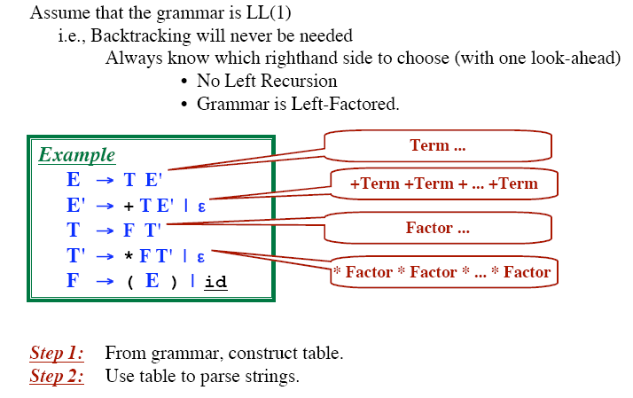
Table Driven Predictive Parsing

Slide 46
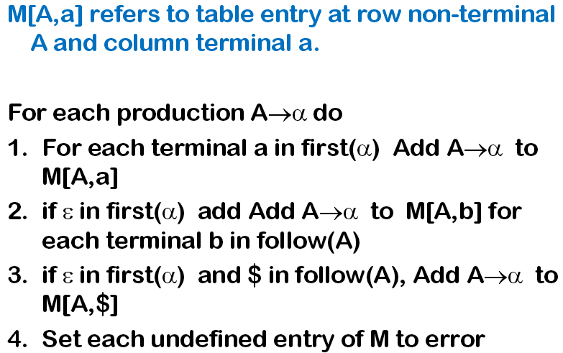
Parse Table Construction

Slide 47
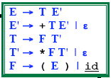
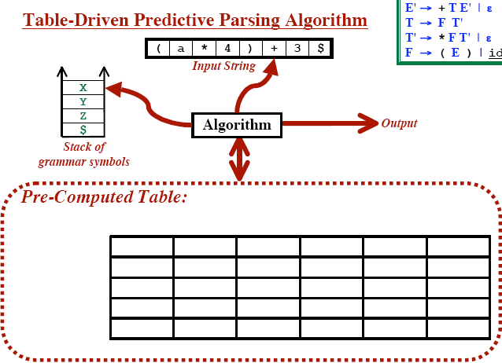
Table Driven Predictive Parsing

Slide 48
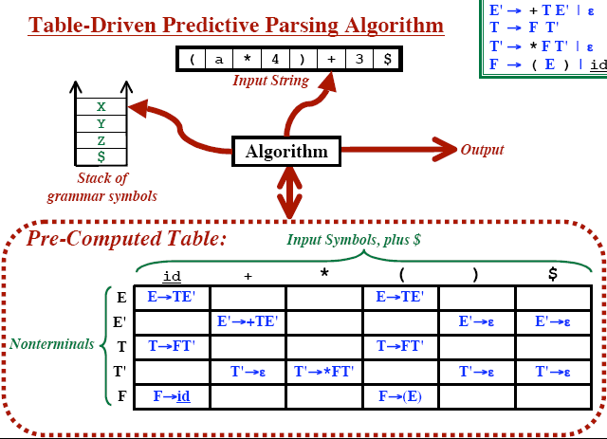
Table Driven Predictive Parsing

Slide 49
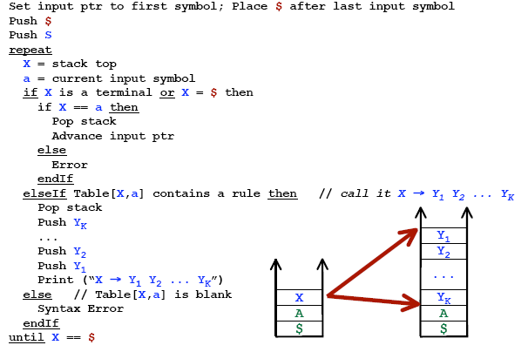
Predictive Parsing Algorithm

Slide 50
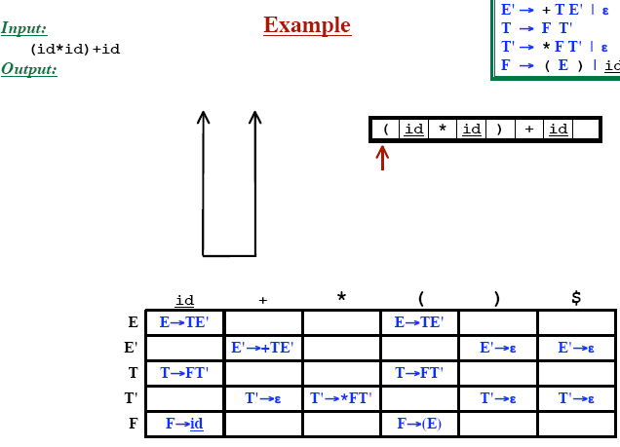
Predictive Parsing

Slide 51
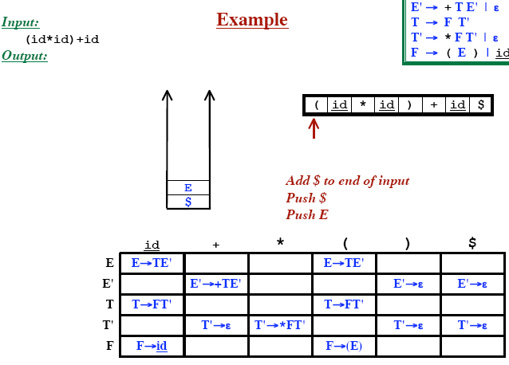
Predictive Parsing

Slide 52
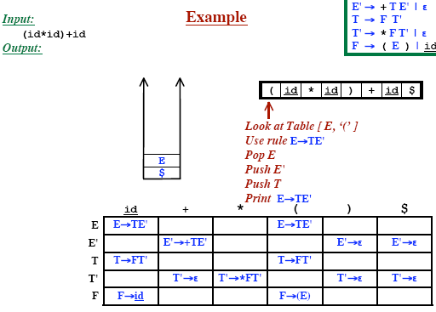
Predictive Parsing

Slide 53
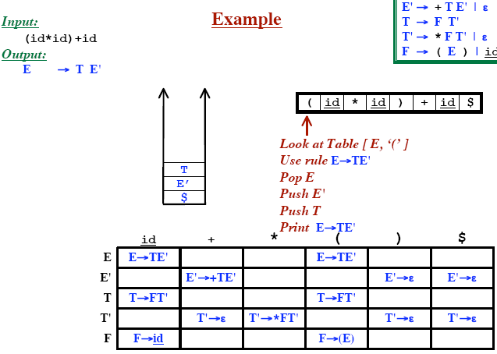
Predictive Parsing

Slide 54
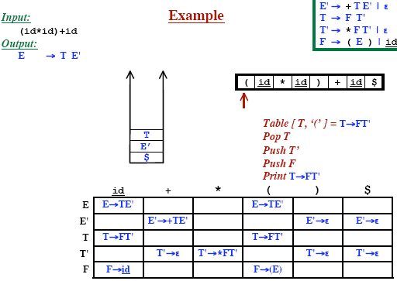
Predictive Parsing

Slide 55
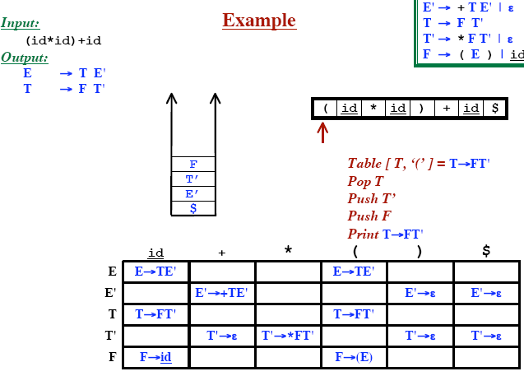
Predictive Parsing

Slide 56
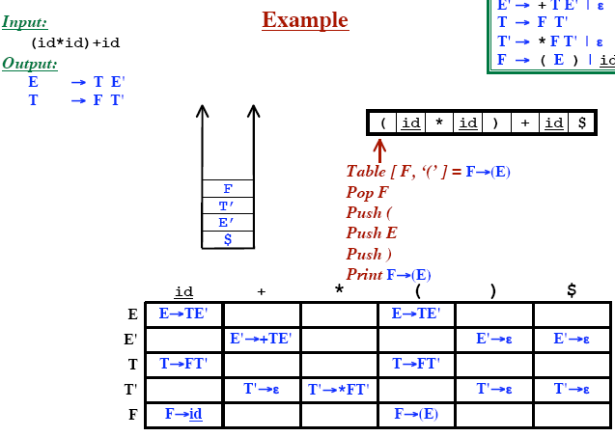
Predictive Parsing

Slide 57
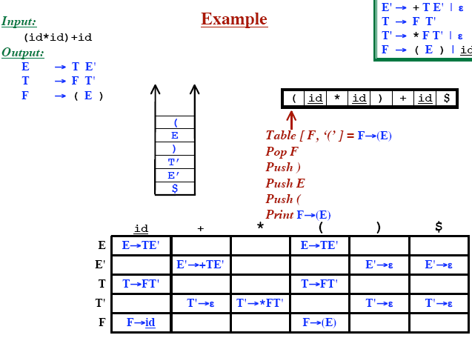
Predictive Parsing

Slide 58
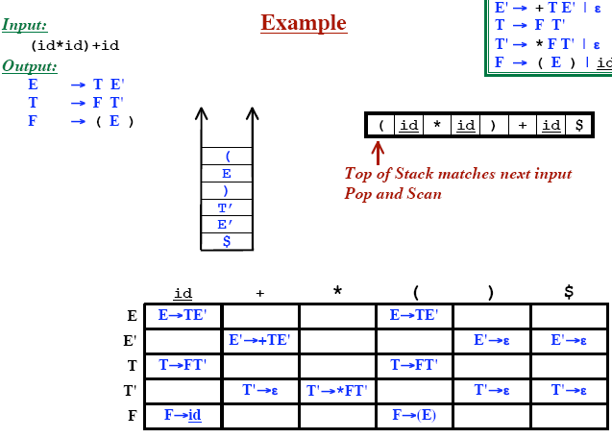
Predictive Parsing

Slide 59
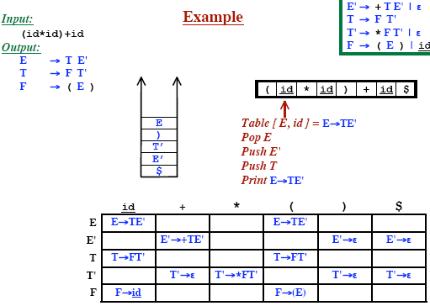
Predictive Parsing

Slide 60
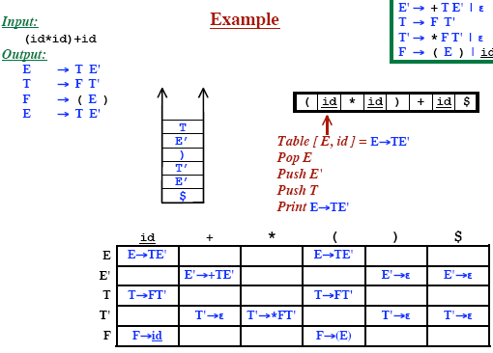
Predictive Parsing

Slide 61
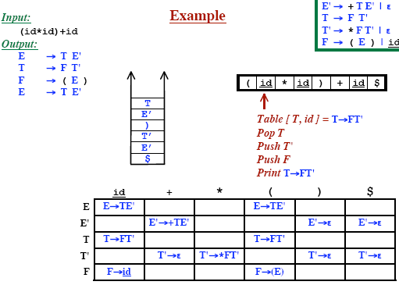
Predictive Parsing

Slide 62
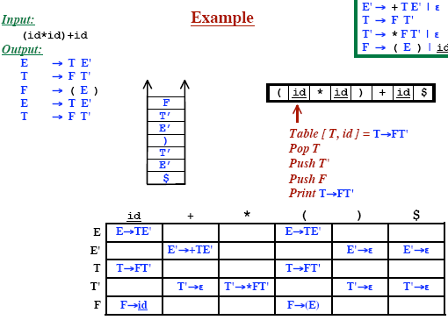
Predictive Parsing

Slide 63
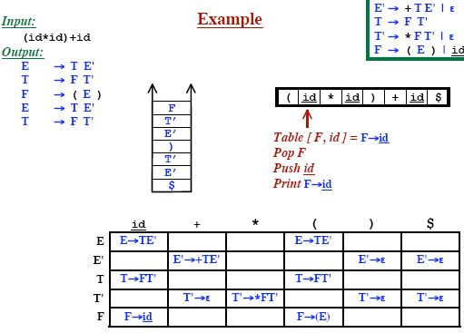
Predictive Parsing

Slide 64
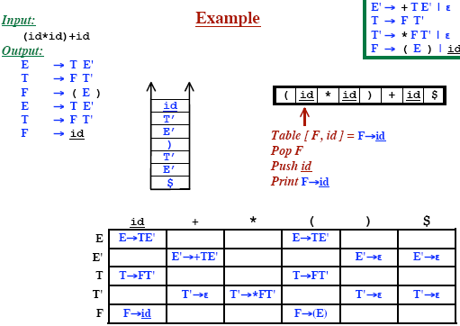
Predictive Parsing

Slide 65
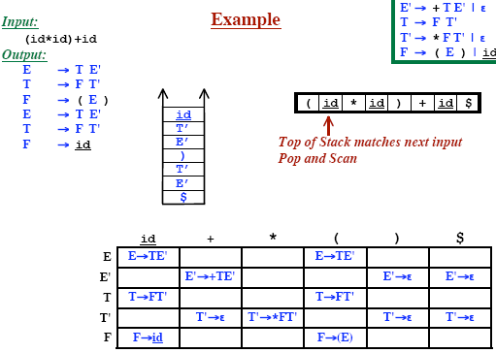
Predictive Parsing

Slide 66
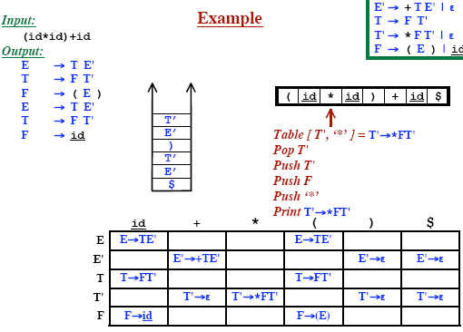
Predictive Parsing

Slide 67
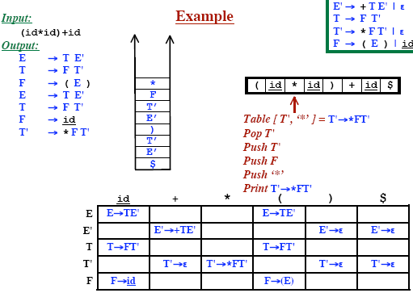
Predictive Parsing

Slide 68
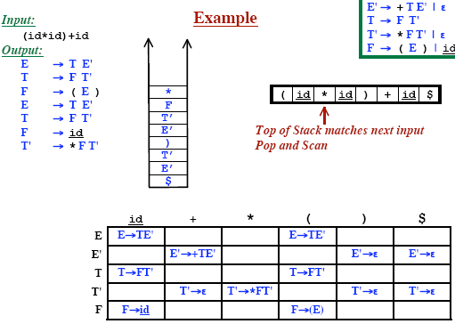
Predictive Parsing

Slide 69
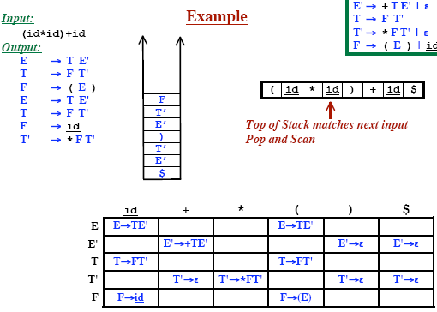
Predictive Parsing

Slide 70
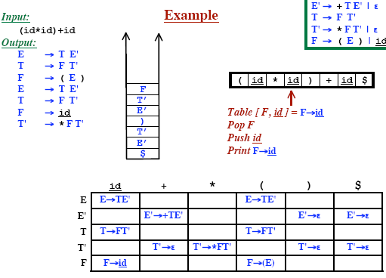
Predictive Parsing

Slide 71
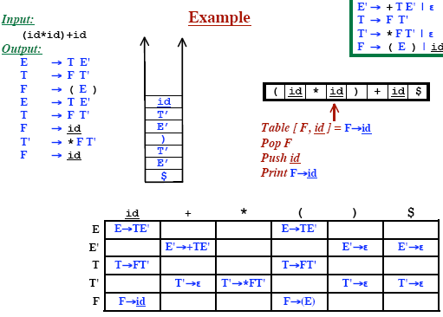
Predictive Parsing

Slide 72

Predictive Parsing

Slide 73
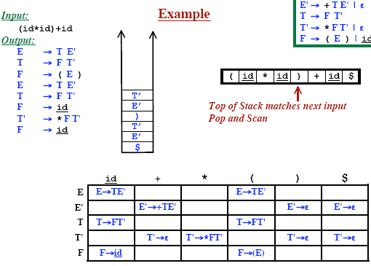
Predictive Parsing

Slide 74
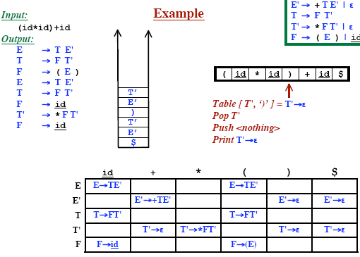
Predictive Parsing

Slide 75
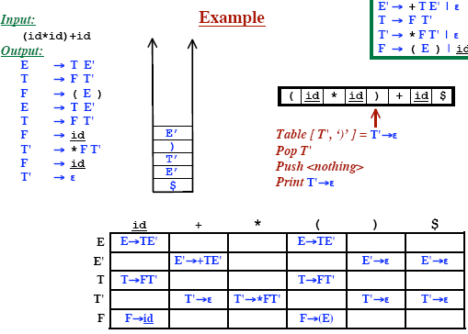
Predictive Parsing

Slide 76

Predictive Parsing

Slide 77

Predictive Parsing

Slide 78

Predictive Parsing

Slide 79

Predictive Parsing

Slide 80

Predictive Parsing

Slide 81

Predictive Parsing

Slide 82

Predictive Parsing

Slide 83

Predictive Parsing

Slide 84

Predictive Parsing

Slide 85

Predictive Parsing

Slide 86

Predictive Parsing

Slide 87

Predictive Parsing

Slide 88

Predictive Parsing

Slide 89

Predictive Parsing

Slide 90

Predictive Parsing

Slide 91

Predictive Parsing

Slide 92

Predictive Parsing

Slide 93

Predictive Parsing

Slide 94

Predictive Parsing

Slide 95

Predictive Parsing

Slide 96

Predictive Parsing

Slide 97






Reconstructing the Parse Tree

Slide 98


Reconstructing the Parse Tree

Slide 99


Reconstructing the Parse Tree

Slide 100


Slide 101

Example: The “Dangling Else” Grammar

Slide 102

Example: The “Dangling Else” Grammar

Slide 103

Example: The “Dangling Else” Grammar

Slide 104

Example: The “Dangling Else” Grammar

Slide 105

Example: The “Dangling Else” Grammar

Slide 106

Example: The “Dangling Else” Grammar

Slide 107

Example: The “Dangling Else” Grammar

Slide 108

Example: The “Dangling Else” Grammar

Slide 109

Example: The “Dangling Else” Grammar

Slide 110

Example: The “Dangling Else” Grammar

Slide 111

Example: The “Dangling Else” Grammar

Slide 112

LL(1) Grammar
LL(1) Grammar
LL(1) grammars
  Are never ambiguous.
  Will never have left recursion.
Furthermore...
  If we are looking for an “A” and the next symbol is “b”,
  Then only one production must be possible
Although elimination of left recursion and left factoring is easy.
  Some grammar will never be a LL(1) grammar.

Slide 113

LL(1) Grammar

Slide 114
Properties of LL(1) Grammar
A grammar G is LL(1) if an only if whenever A →α | β are two distinct productions of G the following conditions hold:
    For no terminal a do both α and β derive strings beginning with a.
    At most one of α and β can derive the empty string.
    If then β ⇒* ε , then α does not derive any string beginning with a terminal in FOLLOW(A), and vice versa

Slide 115
Questions ?

